Slide 1
Chapter 18
How to secure a database

Slide 2
Objectives
Applied
Create both admin and end users, including specifying when a password expires and when a password can be reused.
Grant privileges to users.
Change a user’s password.
Create roles, grant privileges to the roles, and assign users to the roles.
Use SELECT statements to view the privileges for a user or role.
Use MySQL Workbench to work with users and their privileges.

Slide 3
Objectives (continued)
Knowledge
Distinguish between administrative privileges and object privileges.
Describe what a user can do when given any of these privileges for a MySQL object: SELECT, UPDATE, INSERT, DELETE, and EXECUTE.
Distinguish between the four privilege levels.
Describe how MySQL uses grant tables.

Slide 4
A script that creates two users and grants them privileges
CREATE USER ap_admin@localhost IDENTIFIED BY 'pa55word';
CREATE USER ap_user@localhost IDENTIFIED BY 'pa55word';
GRANT ALL
ON ap.*
TO ap_admin@localhost;
GRANT SELECT, INSERT, UPDATE, DELETE
ON ap.*
TO ap_user@localhost;
A statement that displays the privileges for the ap_admin user
SHOW GRANTS FOR ap_admin@localhost

Slide 5
Privileges for working with data
SELECT
INSERT
UPDATE
DELETE
EXECUTE

Slide 6
Privileges for modifying the database structure
CREATE
ALTER
DROP
INDEX
CREATE VIEWS
CREATE ROUTINE
ALTER ROUTINE
TRIGGER
EVENT

Slide 7
Administrative privileges
CREATE USER
CREATE ROLE
SHOW DATABASES
SHUTDOWN
Other privileges
ALL [PRIVILEGES]
GRANT OPTION
USAGE

Slide 8
The four privilege levels
Global
Database
Table
Column
Some of the grant tables in the mysql database
user
db
tables_priv
columns_priv
procs_priv

Slide 9
The simplified syntax of the CREATE USER statement
CREATE USER [IF NOT EXISTS] username
[IDENTIFIED BY password]
[PASSWORD EXPIRE [DEFAULT|NEVER|INTERVAL days DAY] |
PASSWORD HISTORY {DEFAULT|number_passwords} |
PASSWORD REUSE INTERVAL {DEFAULT|days DAY}]
Create a user from a specific host
CREATE USER joel@localhost IDENTIFIED BY 'sesame'
Create a user from any host
CREATE USER IF NOT EXISTS jane IDENTIFIED BY 'sesame' -- creates jane@%

Slide 10
Create a user whose password expires immediately
CREATE USER anne@localhost PASSWORD EXPIRE
Create a user whose last five passwords can’t be reused
CREATE USER jim IDENTIFIED BY 'sesame' PASSWORD HISTORY 5
Create a user whose passwords can’t be reused for 365 days
CREATE USER john IDENTIFIED BY 'sesame' PASSWORD REUSE INTERVAL 365 DAY

Slide 11
The syntax of the RENAME USER statement
RENAME USER username TO new_username
Rename a user from a specific host
RENAME USER joel@localhost TO joelmurach@localhost

Slide 12
The syntax of the DROP USER statement
DROP USER [IF EXISTS] username
A statement that drops a user from a specific host
DROP USER joelmurach@localhost
A statement that drops a user from any host
DROP USER IF EXISTS jane -- drops jane@%

Slide 13
The syntax of an account name
username[@hostname]
A user that can only connect from the same server as MySQL
john@localhost
The same user with optional quotation marks
'john'@'localhost'
The same user with an IP address
john@127.0.0.1

Slide 14
A user that can connect from any computer
john
The same user but with the wildcard character
john@'%'
A user that can only connect from the murach.com domain
john@'%.murach.com'
A username that needs to be coded with quotes
'quinn-the-mighty'@'%.murach.com'

Slide 15
The syntax of the GRANT statement
GRANT privilege_list
ON [db_name.]table
TO user1 [, user2 ]...
[WITH GRANT OPTION]

Slide 16
Grant global privileges to a user
GRANT ALL
ON *.*
TO jim
WITH GRANT OPTION
Grant database privileges to a user
GRANT SELECT, INSERT, UPDATE
ON ap.*
TO joel@localhost
Grant table privileges to a user
GRANT SELECT, INSERT, UPDATE
ON ap.vendors
TO joel@localhost

Slide 17
Grant column privileges to a user
GRANT SELECT (vendor_name, vendor_state,
vendor_zip_code),
UPDATE (vendor_address1)
ON ap.vendors
TO joel@localhost
Grant privileges on the current database
GRANT SELECT, INSERT, UPDATE, DELETE
ON vendors
TO ap_user@localhost
Give a user the ability to grant privileges to other users
GRANT USAGE
ON *.*
TO anne@localhost
WITH GRANT OPTION

Slide 18
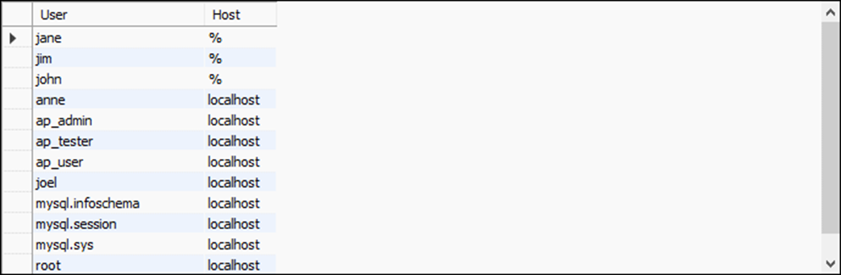
A statement that displays a list of users
SELECT User, Host FROM mysql.user

Slide 19

The syntax of the SHOW GRANTS statement
SHOW GRANTS [FOR user]
Show the privileges for a user from any host
SHOW GRANTS FOR jim
Show the privileges for a user from a specific host
SHOW GRANTS FOR ap_user@localhost
Show the privileges for the current user
SHOW GRANTS

Slide 20
The REVOKE statement for all privileges
REVOKE [IF EXISTS] ALL[ PRIVILEGES], GRANT OPTION
FROM user1[, user2]...
[IGNORE UNKNOWN USER]
Revoke all privileges from a user
REVOKE ALL, GRANT OPTION
FROM jim
Revoke all privileges from multiple users
REVOKE IF EXISTS ALL, GRANT OPTION
FROM ap_user, anne@localhost
IGNORE UNKNOWN USER

Slide 21
The REVOKE statement for specific privileges
REVOKE [IF EXISTS] privilege_list
ON [db_name.]table
FROM user1[, user2]...
IGNORE UNKNOWN USER
Revoke specific privileges from a user
REVOKE INSERT, UPDATE
ON ap.vendors FROM joel@localhost

Slide 22
The syntax of the ALTER USER statement
ALTER USER [IF EXISTS] {username|USER()}
[IDENTIFIED BY 'password']
[PASSWORD EXPIRE [DEFAULT|NEVER|INTERVAL days DAY] |
PASSWORD HISTORY {DEFAULT|number_passwords} |
PASSWORD REUSE INTERVAL {DEFAULT|days DAY}]
Change a user’s password
ALTER USER john IDENTIFIED BY 'pa55word'
Change the current user’s password
ALTER USER USER() IDENTIFIED BY 'secret'
Force a user to change their password every 90 days
ALTER USER IF EXISTS john PASSWORD EXPIRE INTERVAL 90 DAY

Slide 23
Select all users that don’t have passwords
SELECT Host, User
FROM mysql.user
WHERE authentication_string = ‘’
AND password_expired = 'N'

Slide 24
A script that sets up the users and privileges for a database
-- drop the users
DROP USER IF EXISTS john;
DROP USER IF EXISTS jane;
DROP USER IF EXISTS jim;
DROP USER IF EXISTS joel@localhost;
-- create the users
CREATE USER john PASSWORD EXPIRE;
CREATE USER jane PASSWORD EXPIRE;
CREATE USER jim PASSWORD EXPIRE;
CREATE USER joel@localhost PASSWORD EXPIRE;
-- grant privileges to a developer (joel)
GRANT ALL ON *.* TO joel@localhost WITH GRANT OPTION;
-- grant privileges to the ap manager (jim)
GRANT SELECT, INSERT, UPDATE, DELETE ON ap.* TO jim
WITH GRANT OPTION;

Slide 25
A script that sets up the users and privileges for a database (continued)
-- grant privileges to ap users (john, jane)
GRANT SELECT, INSERT, UPDATE, DELETE ON ap.vendors
TO john, jane;
GRANT SELECT, INSERT, UPDATE, DELETE ON ap.invoices
TO john, jane;
GRANT SELECT, INSERT, UPDATE, DELETE
ON ap.invoice_line_items TO john, jane;
GRANT SELECT ON ap.general_ledger_accounts TO john, jane;
GRANT SELECT ON ap.terms TO john, jane;

Slide 26
The syntax of the CREATE ROLE statement
CREATE ROLE [IF NOT EXISTS] role1[, role2]...
A statement that creates a a role
CREATE ROLE invoice_entry

Slide 27
How to grant privileges to roles
GRANT INSERT, UPDATE
ON invoices
TO invoice_entry
GRANT INSERT, UPDATE
ON invoice_line_items
TO invoice_entry

Slide 28
The GRANT statement for assigning users to roles
GRANT role1[, role2]...
TO user1[, user2]...
[WITH ADMIN OPTION]
Assign two users to a role
GRANT invoice_entry TO john, jane

Slide 29
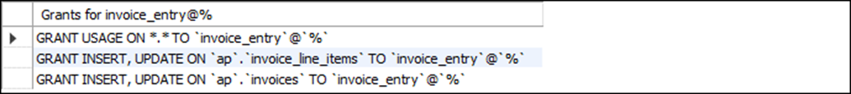
How to display the privileges for a role
SHOW GRANTS FOR invoice_entry

Slide 30
The syntax of the SET DEFAULT ROLE statement
SET DEFAULT ROLE {NONE|ALL|role1[, role2]...}
TO username1[, username2]...
Set the default role for two users
SET DEFAULT ROLE invoice_entry TO john, jane

Slide 31
The syntax of the SET ROLE statement
SET ROLE {DEFAULT|NONE|ALL|ALL EXCEPT role1[, role2]...| role1[, role2]...}
A statement that changes the active role
SET ROLE invoice_entry
How to display the roles that are currently active
SELECT CURRENT_ROLE()

Slide 32
How to revoke privileges from roles
REVOKE UPDATE
ON invoice_line_items
FROM invoice_entry

Slide 33
The REVOKE statement for removing users from roles
REVOKE [IF EXISTS] role1[, role2]...
FROM username1[, username2]...
[IGNORE UNKNOWN USER]
Remove a user from a role
REVOKE IF EXISTS invoice_entry FROM john
IGNORE UNKNOWN USER

Slide 34
The syntax of the DROP ROLE statement
DROP ROLE [IF EXISTS] role1 [, role2]...
A statement that deletes a role
DROP ROLE invoice_entry

Slide 35
A script that sets up the users and roles for a database
-- create the users
CREATE USER IF NOT EXISTS john PASSWORD EXPIRE;
CREATE USER IF NOT EXISTS jane PASSWORD EXPIRE;
CREATE USER IF NOT EXISTS jim PASSWORD EXPIRE;
CREATE USER IF NOT EXISTS joel@localhost PASSWORD EXPIRE;
-- create the roles
CREATE ROLE IF NOT EXISTS developer, manager, user;
-- grant privileges to the developer role
GRANT ALL ON *.* TO developer WITH GRANT OPTION;
-- grant privileges to the manager role
GRANT SELECT, INSERT, UPDATE, DELETE ON ap.* TO manager WITH GRANT OPTION;

Slide 36
A script that sets up the users and roles for a database (continued)
-- grant privileges to user role
GRANT SELECT, INSERT, UPDATE, DELETE ON ap.vendors TO user;
GRANT SELECT, INSERT, UPDATE, DELETE ON ap.invoices TO user;
GRANT SELECT, INSERT, UPDATE, DELETE ON ap.invoice_line_items TO user;
GRANT SELECT ON ap.general_ledger_accounts TO user;
GRANT SELECT ON ap.terms TO user;
-- assign users to roles
GRANT developer TO joel@localhost;
GRANT manager TO jim;
GRANT user TO john, jane;
-- set default roles for users
SET DEFAULT ROLE developer TO joel@localhost;
SET DEFAULT ROLE manager TO jim;
SET DEFAULT ROLE user TO john, jane;

Slide 37
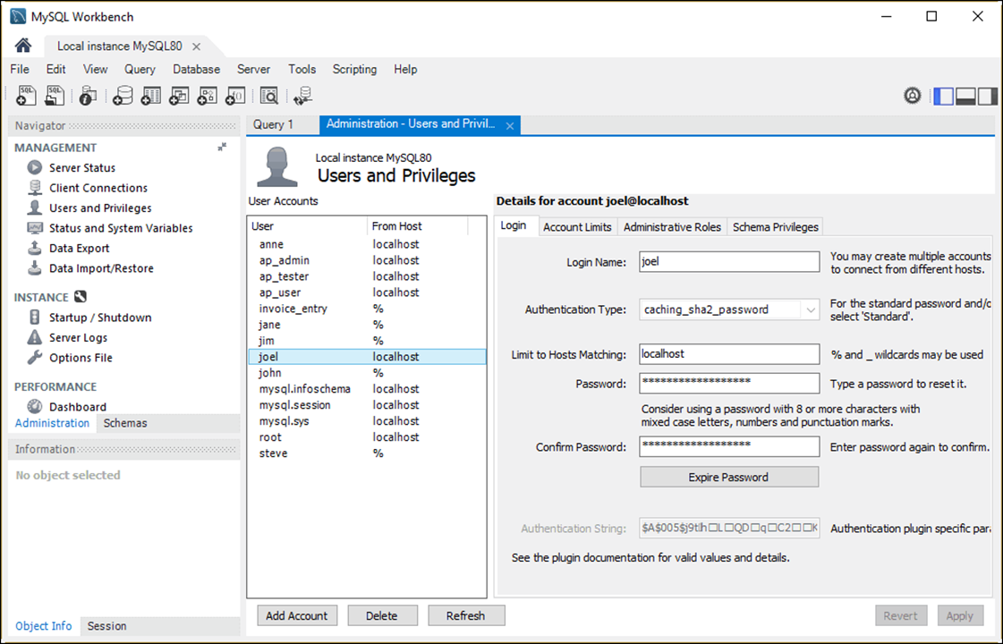
The Login tab

Slide 38
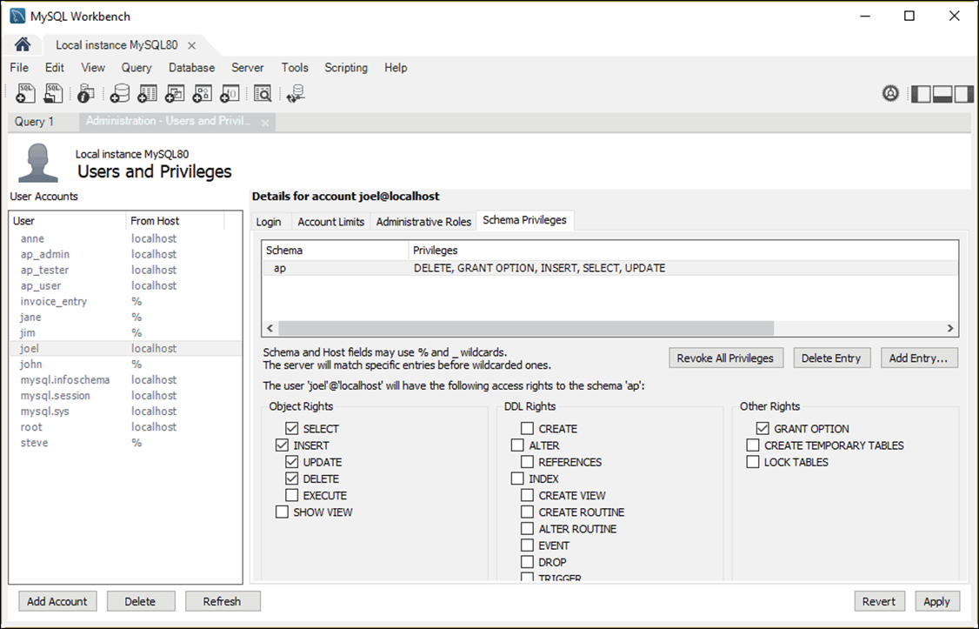
The Schema Privileges tab

Slide 39
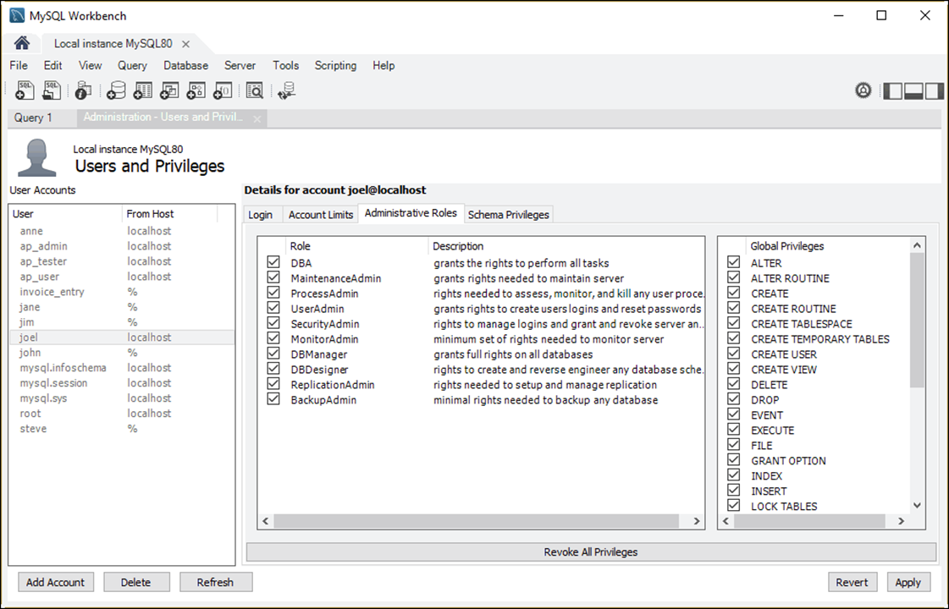
The Administrative Roles tab

Slide 40
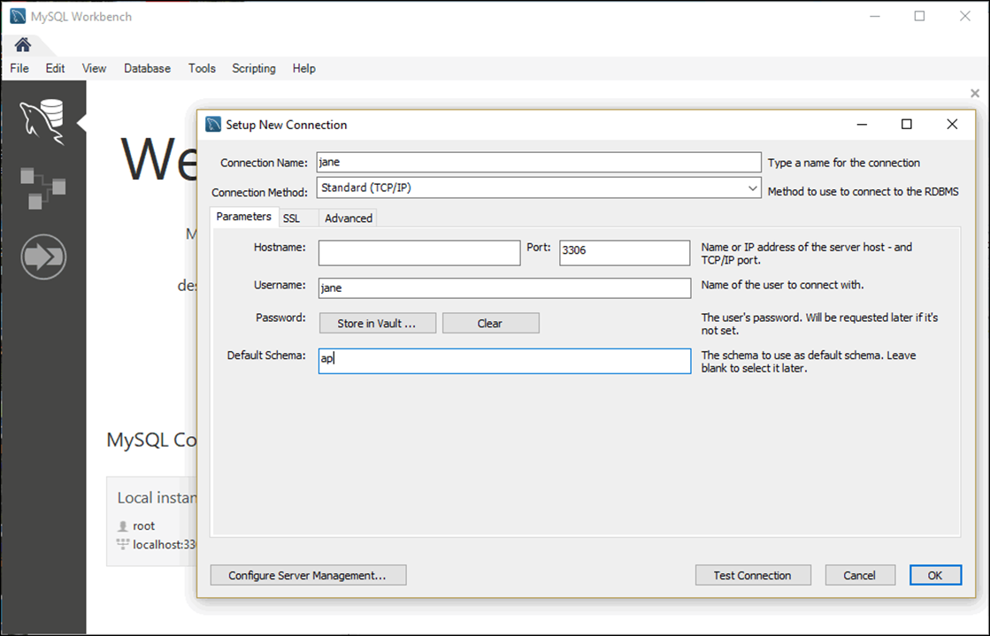
The Setup New Connection dialog box

